Slide 1

94-844 GENERATIVE AI LAB
FINAL PROJECT
GROUP 2

Slide 2
GROUP MEMBERS
Ashwin Kandath
Hoklam Cheung
Praneet Yavagal
Rahul Pujari
Yukti Shah

Slide 3
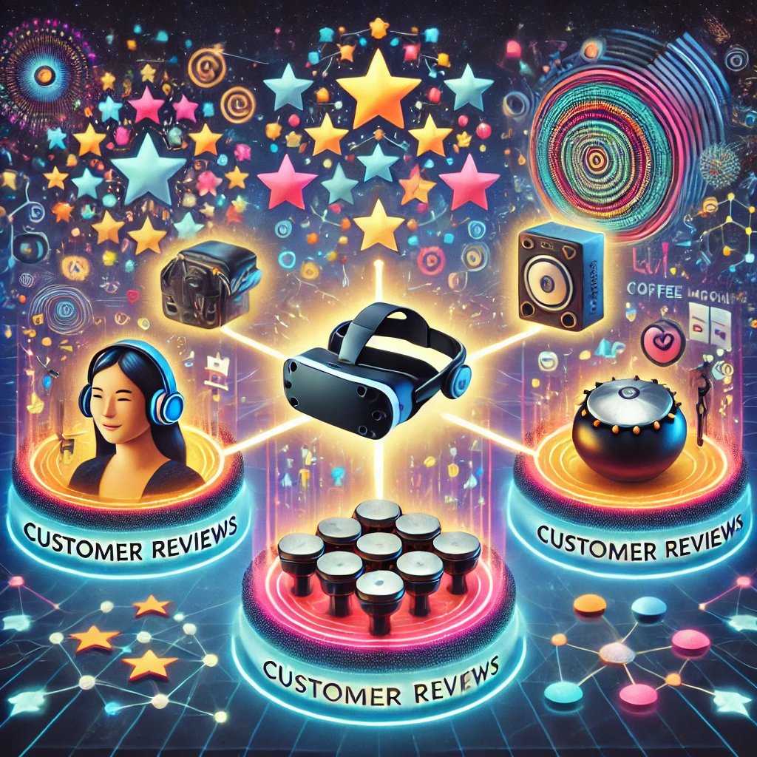
HARNESSING GENERATIVE AI FOR TEXT-TO-IMAGE SYNTHESIS
This project explores the intersection of textual and visual generative AI using LLMs and diffusion models.
Customer reviews of three products were analyzed for visual features and sentiment, guiding image generation with models like DALLE and Stable Diffusion to evaluate AI's ability to translate text into accurate visuals.
(Generated using ChatGPT)
Notes:
This project explores the intersection of textual and visual generative AI, combining the interpretative strengths of large language models (LLMs) and the creative capabilities of diffusion models. We analyzed customer reviews of three diverse products to extract valuable insights, focusing on visual features and sentiment. These insights were used to craft prompts for image generation using diffusion models like DALLE and Stable Diffusion. By comparing AI-generated visuals with real-world product images, we assessed the fidelity and effectiveness of AI in translating textual descriptions into accurate and meaningful imagery.

Slide 4




Product Selection and Customer Review Data
Analysis of Product Descriptions with LLM
Image Generation with Diffusion Model
Discussion and Summary

Slide 5





WE LOOKED AT AMAZON TO CHOOSE CATEGORIES BASED ON THE REVENUE THEY GENERATE
Kitchen & Home
>90th %ile
List of categories by revenue share
Electronics
~50th %ile
Musical Instruments
<10th %ile
Source: December 6, Brian Connolly, and 2023. 2023. “Top Amazon Product Categories in 2024.” Jungle Scout. December 6, 2023. https://www.junglescout.com/resources/articles/amazon-product-categories/

Slide 6
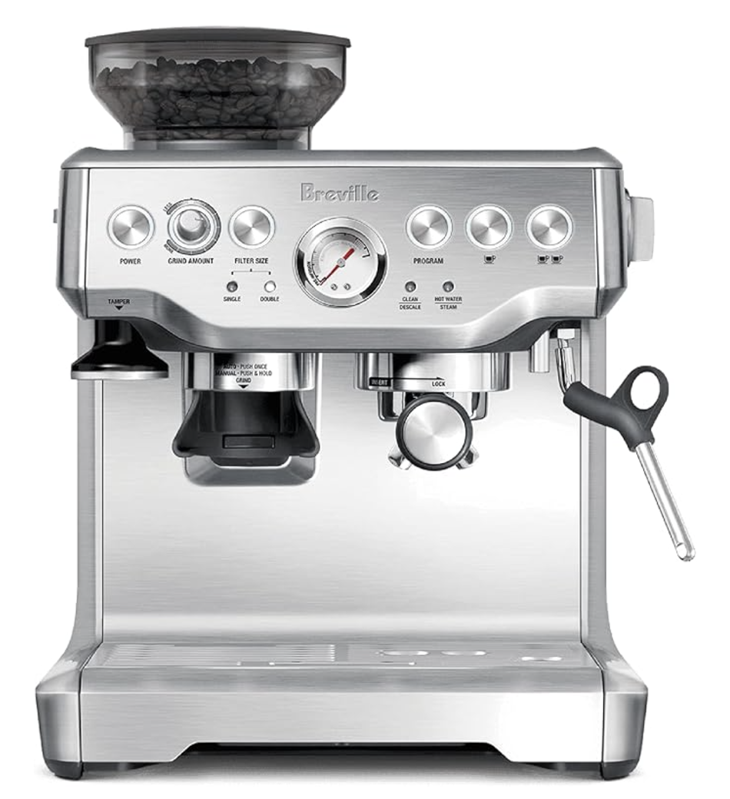
BREVILLE COFFEE MACHINE
Kitchen & Home
This product belongs to the ‘Kitchen and Home Appliances’ category, which contributes the most in Amazon’s e-commerce revenue
We chose this specific product since there are many different types of coffee machines on Amazon, and we wanted to see how would our image generation model do to create a similar looking image

Slide 7
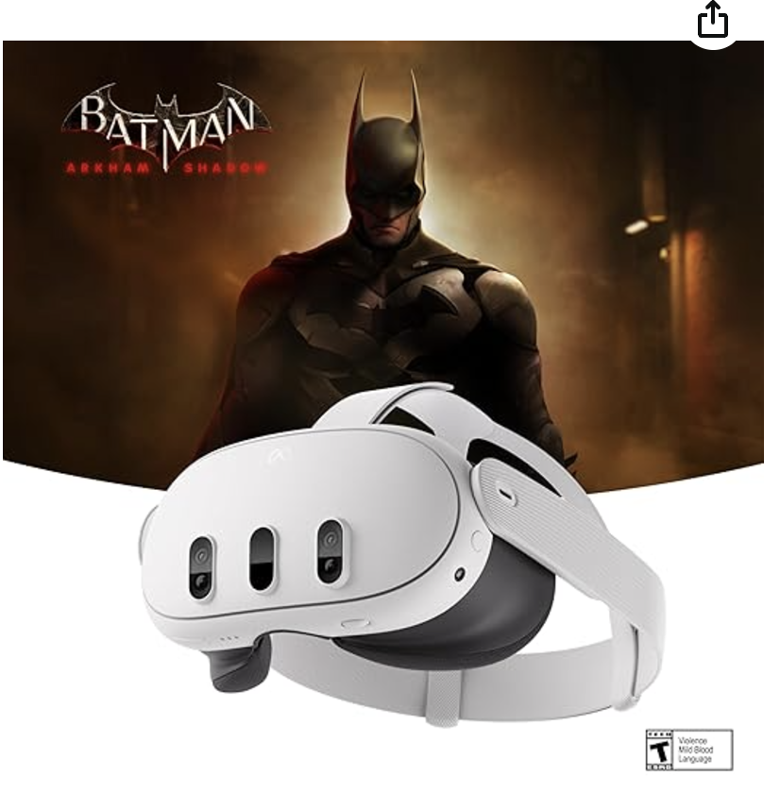
META QUEST 3
Electronics
This product belongs to the ‘Electronics’ category, which is somewhere in the middle of the list of categories on Amazon, by e-commerce revenue
We chose this specific product as we expected that this product could be relatively easier to generate, given that it is well-known.
With this, we wanted to see how our model does on the easier tasks

Slide 8
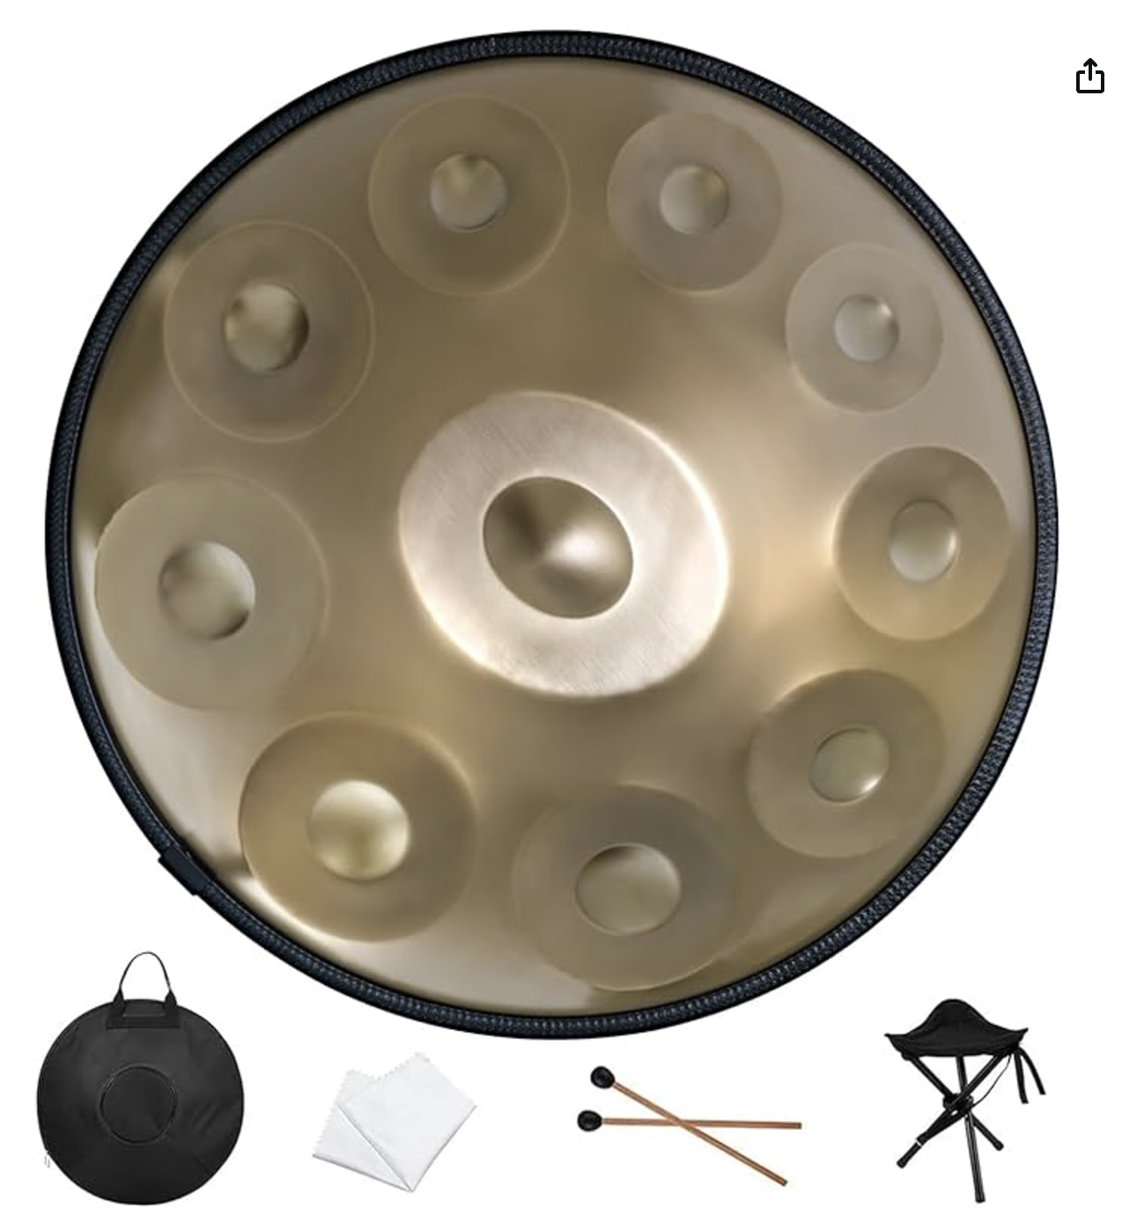
HANDPAN DRUM
Musical Instruments
This product belongs to the ‘Musical Instruments’ category, which contributes the least in Amazon’s e-commerce revenue
We chose this specific product since it is a relatively lesser-known instrument, constituting words like ‘hand’, ‘pan’ and ‘drum’, which clearly does not evidently describe what the object could look like
With this, we wanted to see how well it understands the reviews and description to generate the image

Slide 9
Product Selection and Customer Review Data
Analysis of Product Descriptions with LLM
Image Generation with Diffusion Model
Discussion and Summary

Slide 10
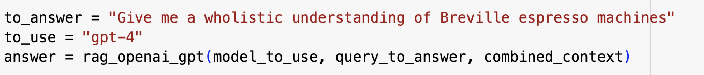
RAG: GENERAL SUMMARY
Set K = 10, and ask for the information of coffee machine only
Retrieve the information and bring it to LLM API and ask it to generate "wholistic understanding of the coffee machine" based on the retrieve content

Slide 11
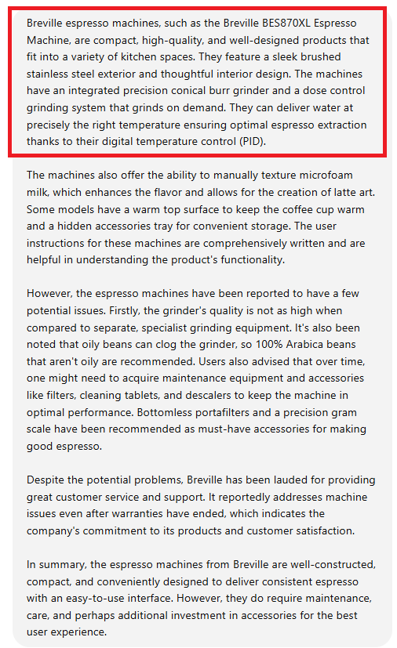
RAG: GENERAL SUMMARY
A good summary of the product, likes its pros & cons
Benefits for the potential buyer to understand the product and compare the similar product
Help the company to extract the key information of user review
Less visual information about the product
May not be accurate for the image generation

Slide 12
RAG: ADD VISUAL KEYWORD
Set K = 10, and ask for the information of coffee machine only
Retrieve the information and bring it to LLM API and ask it to generate "bullet points of visual information of the coffee machine" based on the retrieve content

Slide 13
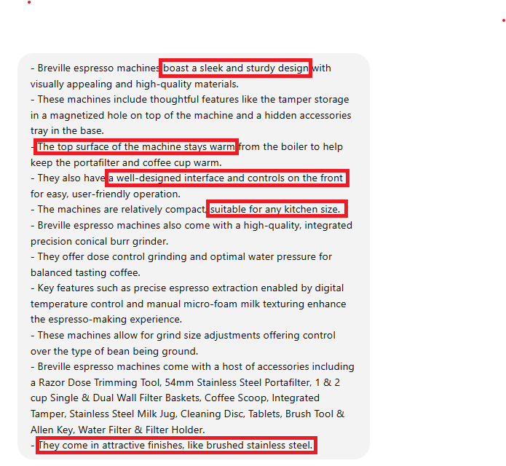
RAG: VISUAL INFORMATION
Most of the bullet points describe the machine in detail
Shape, Color, Key feature of the outlook
Align with our goal to generate the image

Slide 14
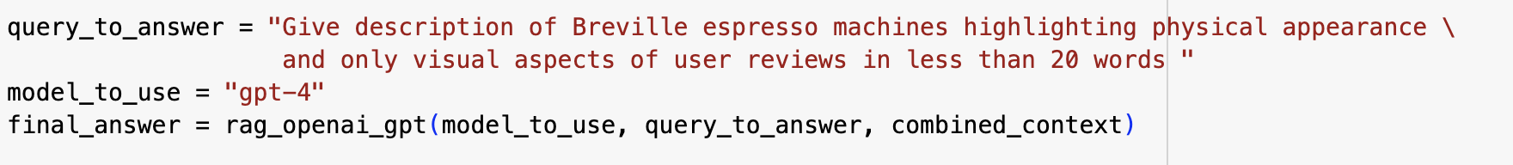
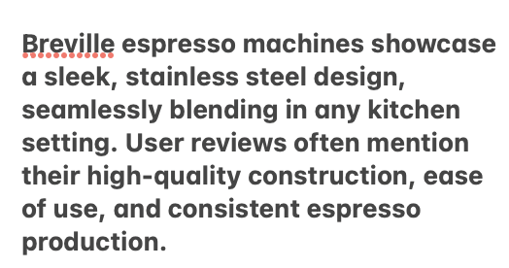
SENTIMENT ANALYSIS
Incorporate user feedback on design, functionality, and performance to enrich visual descriptions

Slide 15
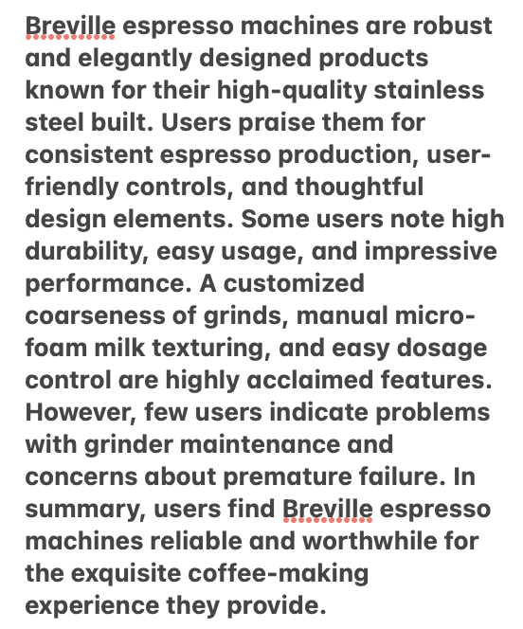
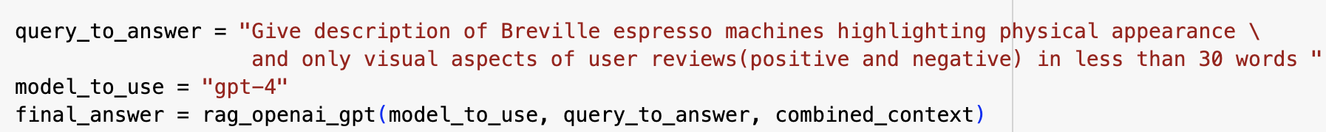
SENTIMENT ANALYSIS – ADD BETTER CONTEXT
Encouraged more specific and visually rich information, improving the image's quality and accuracy

Slide 16
FINAL GOAL OF PROMPT DESIGN
Our goal was not to create a depiction identical to the actual product but to leverage both positive and negative user reviews to craft a realistic representation.
By balancing praised features with constructive criticism, we aimed to ensure the visualizations conveyed an authentic and relatable product experience

Slide 17
Product Selection and Customer Review Data
Analysis of Product Descriptions with LLM
Image Generation with Diffusion Model
Discussion and Summary

Slide 18
IMAGE GENERATION MODELS USED
DALL-E-3 (OpenAI):
Better for creative, abstract, or artistic depictions
Allows flexibility with how products are visualized
Stable Diffusion 3.5 Large (Stability AI):
Better for realistic and detailed product representations
Gives a true-to-life or accurate look based on product specifications

Slide 19
PROMPT USED FOR IMAGE GENERATION
We used the following prompt for both the models, only modifying features for every product:
final_prompt =(
f"A high-quality, professional product photo of {image_prompt}.\n"
f"The image should accurately represent the product's visual details.\n"
f"Style: studio lighting, plain background, **no text**, **no logos**, **no text labels**, **no watermarks**.\n"
f"Focus solely on the product."
)
⁠

Slide 20
PRODUCT 1 - BREVILLE COFFEE MACHINE
Prompt :
A high-quality, professional product photo of Breville BES870XL Espresso Machine.
The product has the following characteristics: A stainless steel, all-in-one espresso machine with an integrated grinder. It offers dose control grinding, optimal water pressure, and can go from beans to espresso in under a minute. Ideal for home baristas, it requires additional accessories for optimal use.
The image should accurately represent the product's visual details.
Style: studio lighting, plain background, no text, no logos, no labels, no watermarks. Focus solely on the product.

Slide 21
PRODUCT 1 - BREVILLE COFFEE MACHINE​
Product Image on Amazon

Slide 22
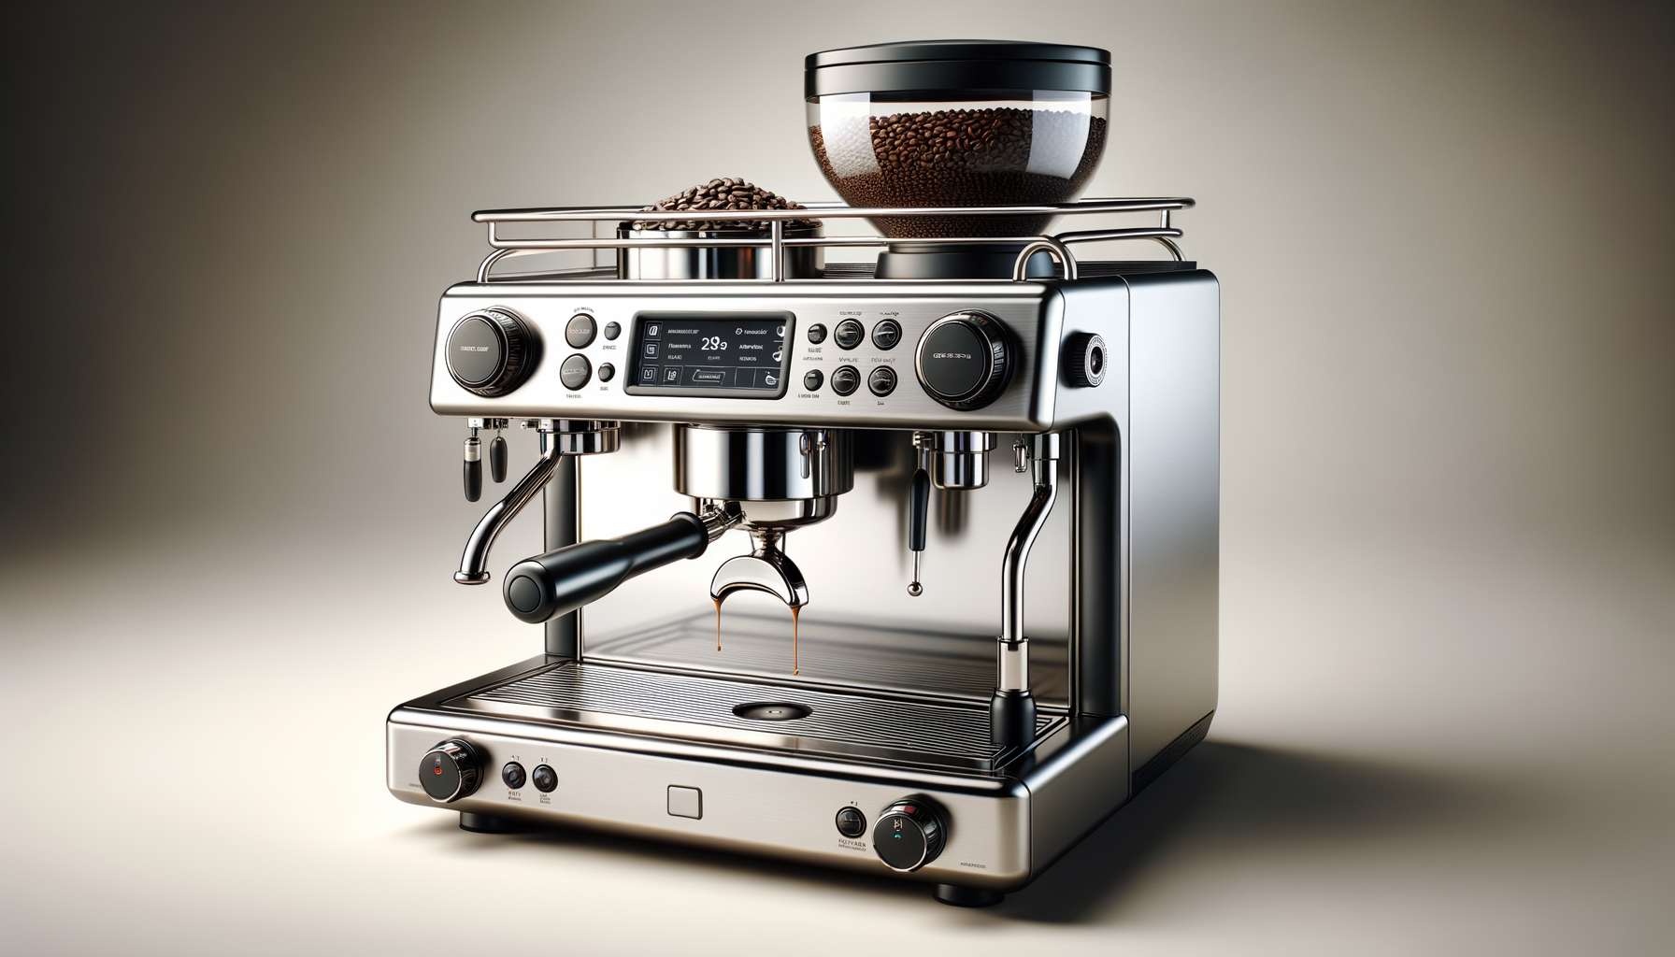
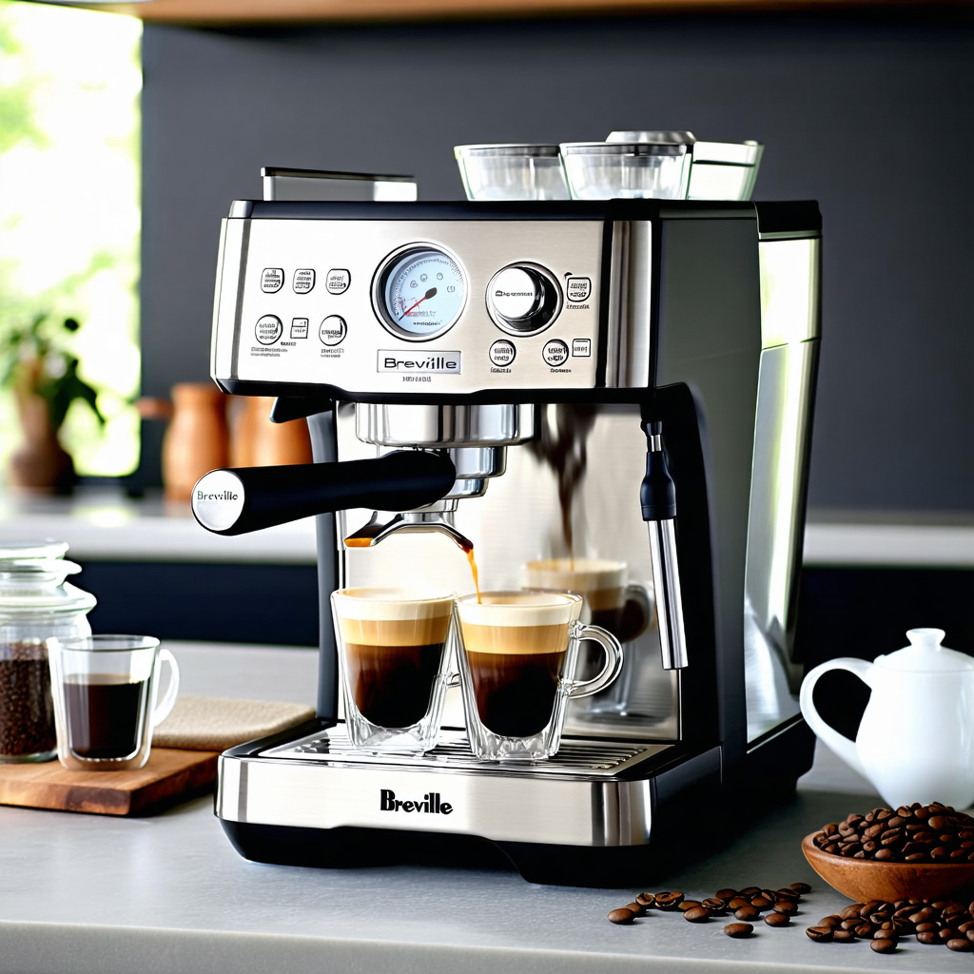
GENERATED IMAGES - BREVILLE COFFEE MACHINE
DALL-E
STABLE DIFFUSION

Slide 23
PRODUCT 1I – META QUEST 3
Prompt :
A high-quality, professional product photo of Meta Quest 3.
The product has the following characteristics: A next-gen VR device with a 512GB capacity. It features a sharper resolution of 2064 x 2208 pixels per eye, a powerful Snapdragon XR2 Gen 2 chip, and full-color passthrough cameras for mixed reality experiences. It also includes a promotional offer for Batman: Arkham Shadow and a 3-month trial of Meta Quest+.
The image should accurately represent the product's visual details.
Style: studio lighting, plain background, no text, no logos, no labels, no watermarks. Focus solely on the product.

Slide 24
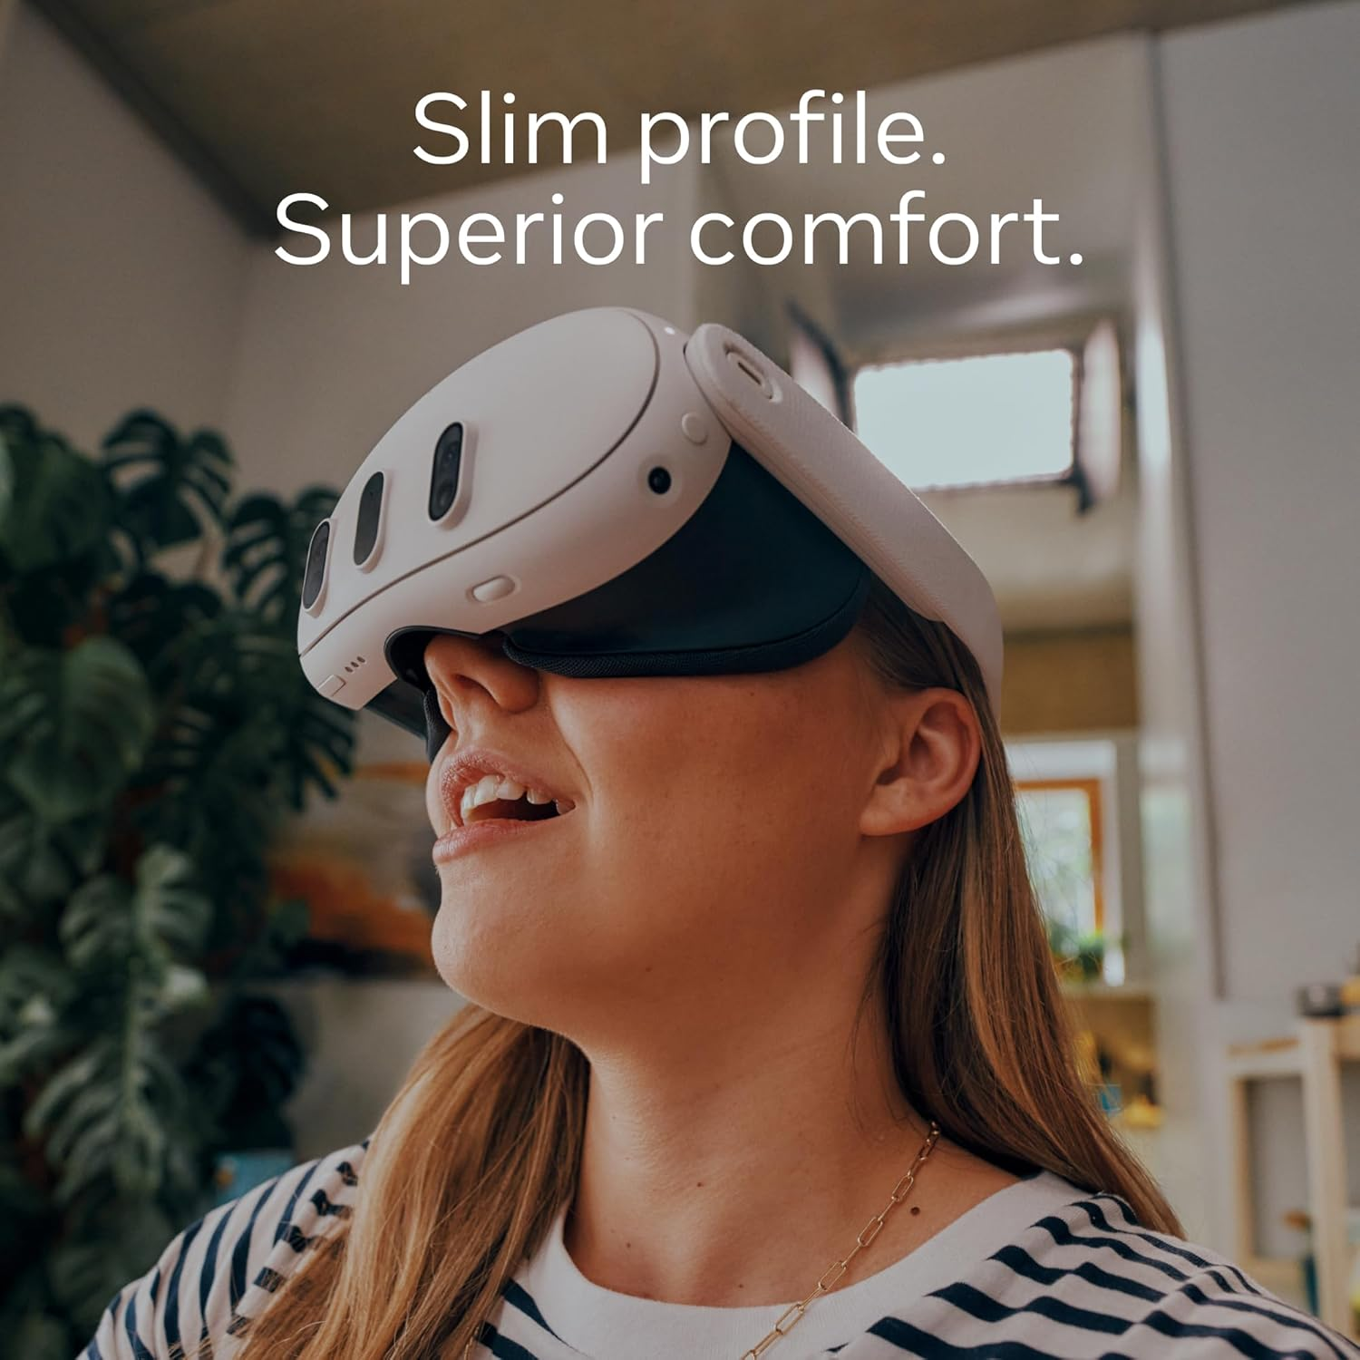
PRODUCT 1I – META QUEST 3
Product Image on Amazon

Slide 25
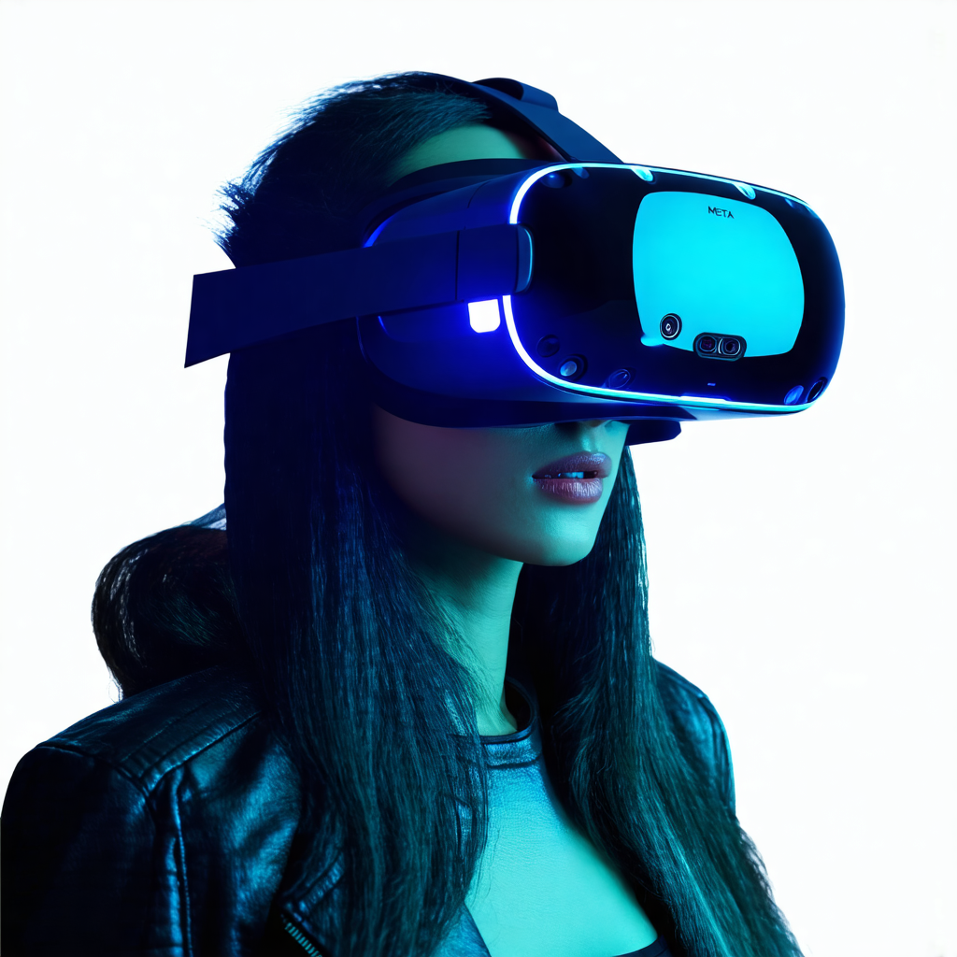
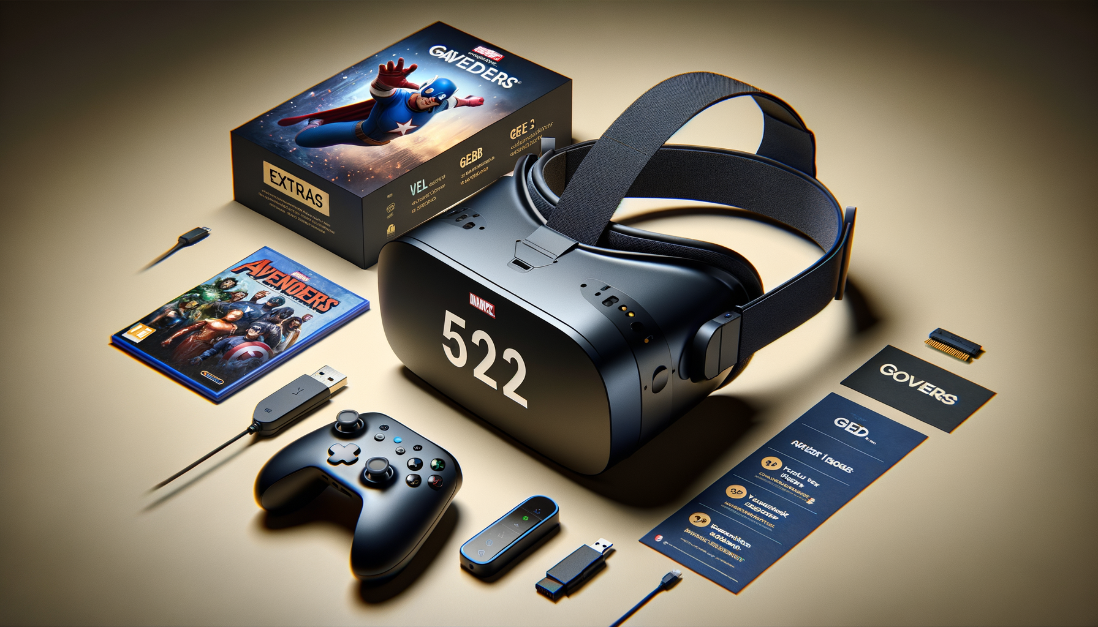
GENERATED IMAGES – META QUEST 3
DALL-E
STABLE DIFFUSION

Slide 26
PRODUCT III – HANDPAN DRUM
Prompt :
A high-quality, professional product photo of The Handpan Drum.
The product has the following characteristics: A 22-inch, 10-note musical instrument made from 1.2mm thick nitrogen steel. It's manually tuned for precise tones, producing an ethereal sound ideal for music education and meditation. The drum comes with a carrying case, stand, drumsticks, and cleaning cloth. It's durable, rust-resistant, and easy to play.
The image should accurately represent the product's visual details.
Style: studio lighting, plain background, no text, no logos, no labels, no watermarks. Focus solely on the product.

Slide 27
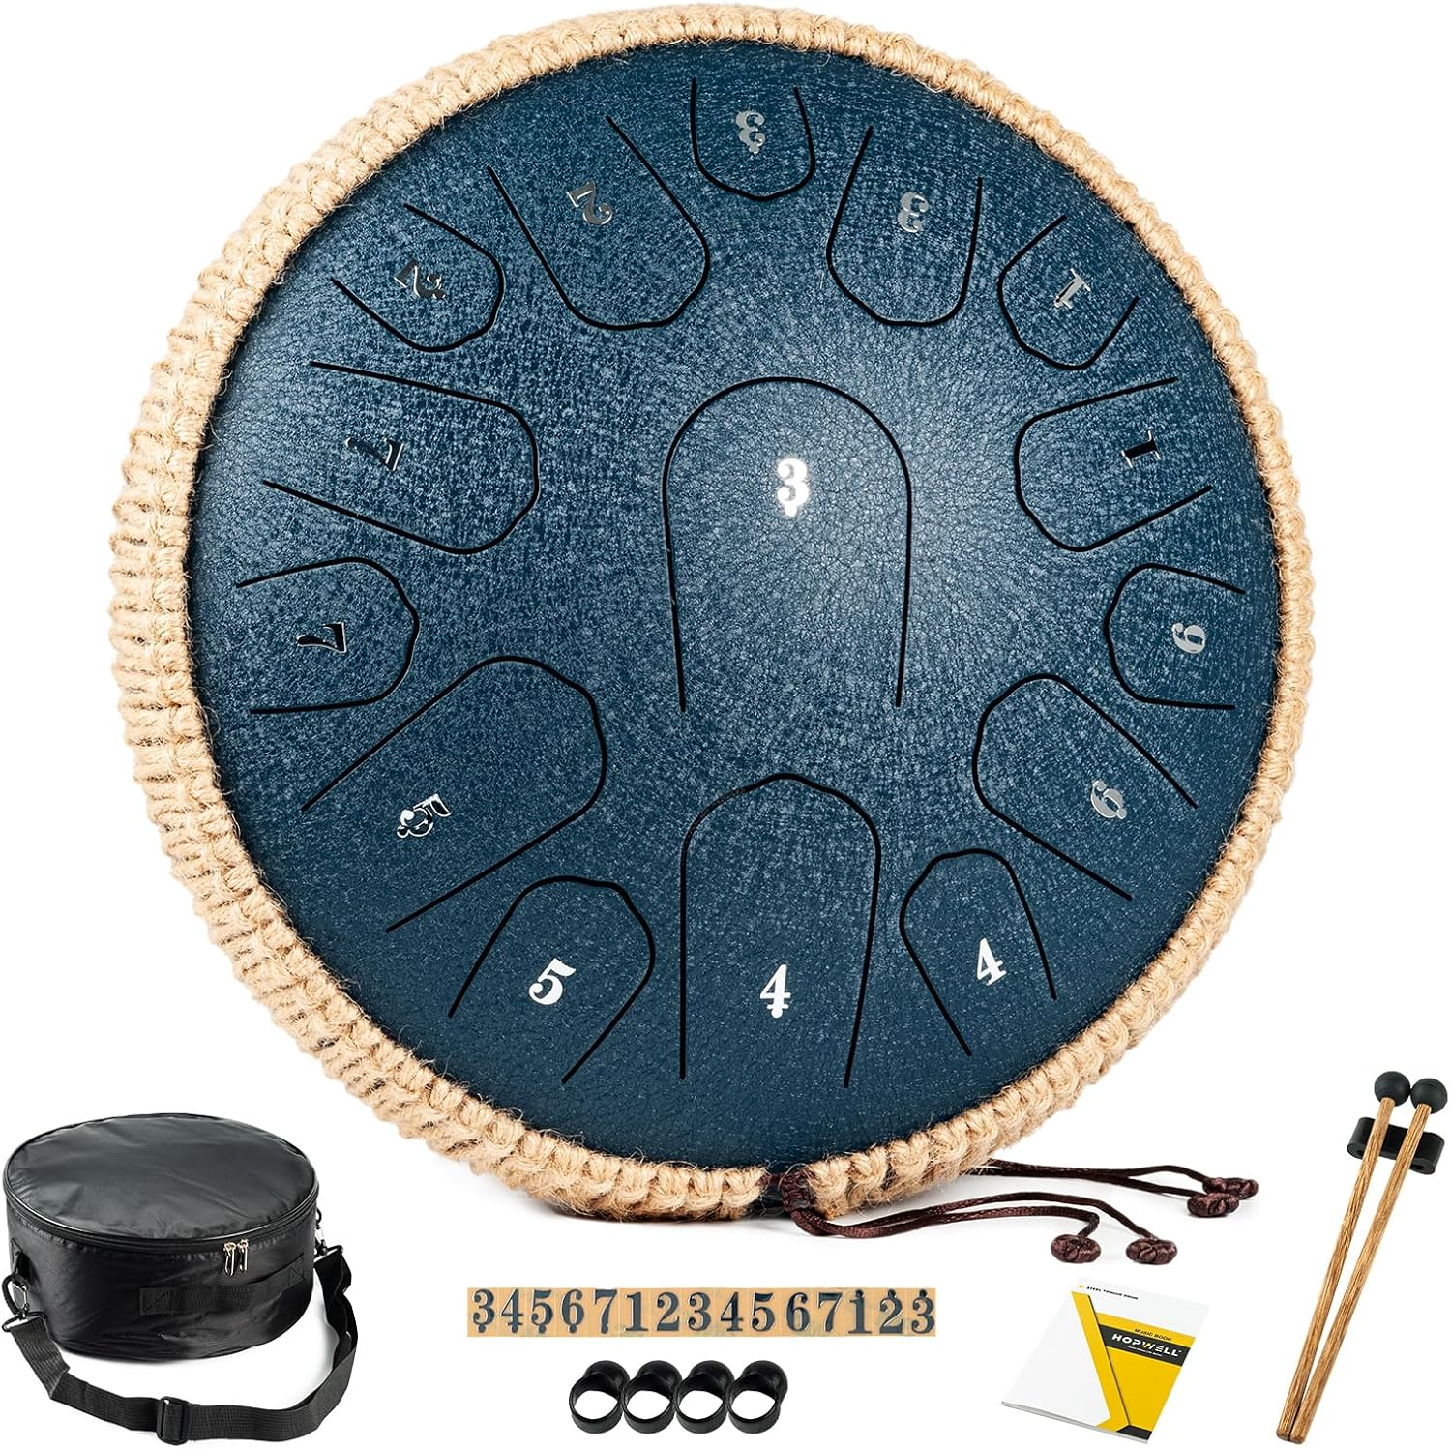
PRODUCT III - HANDPAN DRUM​
Product Image on Amazon

Slide 28
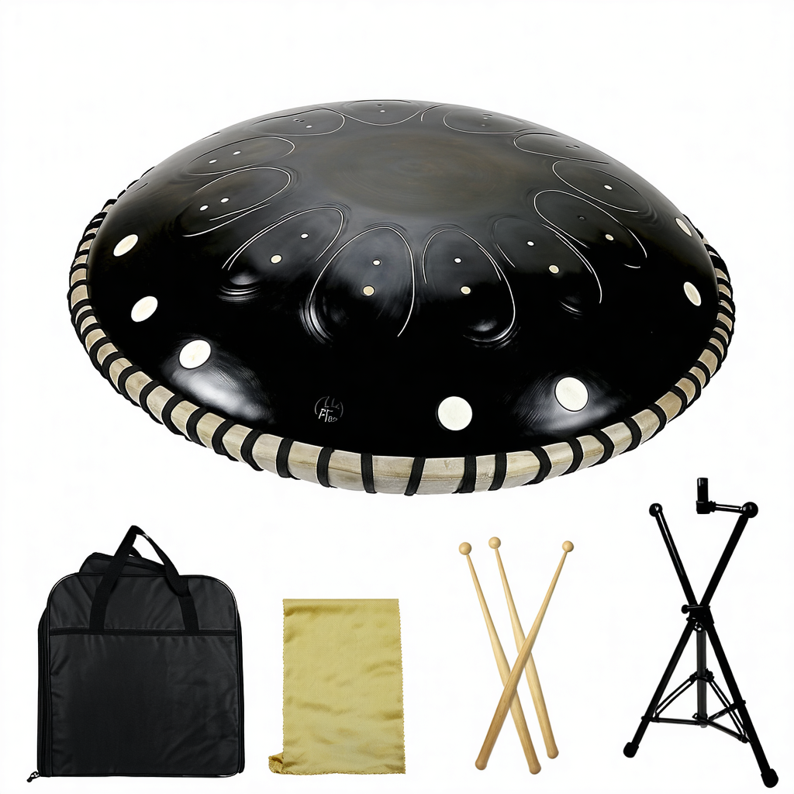
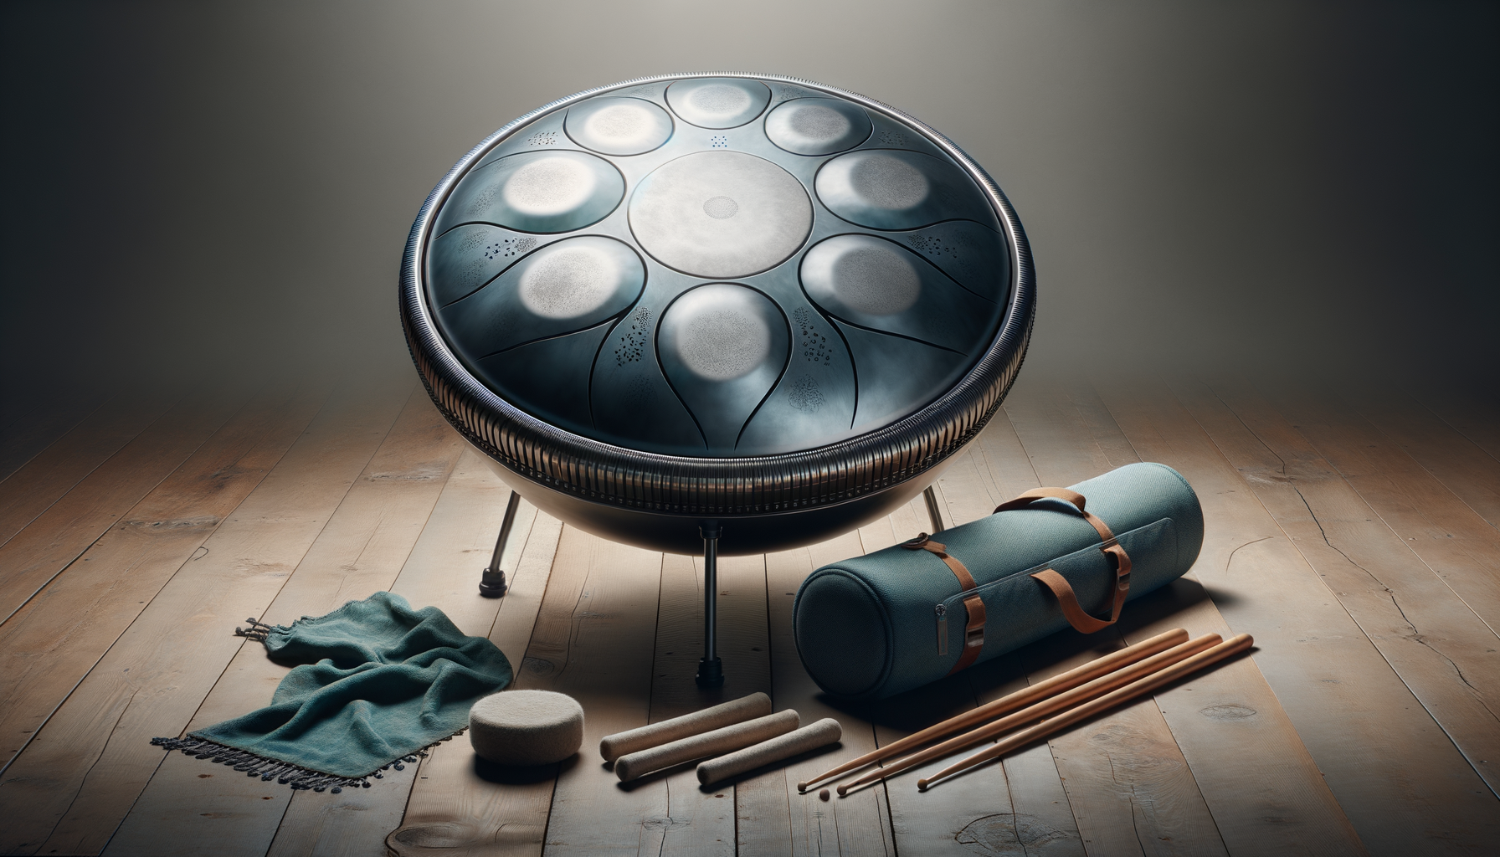
GENERATED IMAGES – HANDPAN DRUM
DALL-E
STABLE DIFFUSION

Slide 29
Product Selection and Customer Review Data
Analysis of Product Descriptions with LLM
Image Generation with Diffusion Model
Discussion and Summary

Slide 30




EVALUATION OF AI'S ILLUSTRATION CAPABILITY
We assessed our models’ capability using 4 criteria
Accuracy
Accurate depiction of key features (product shapes, colors)
Aesthetics
Clean backgrounds and studio-like lighting enhance visual appeal
Detailing
Attention to intricate design elements
Consistency
Reliable focus on the product without distracting elements

Slide 31
COMPARISON OF AI-GENERATED IMAGES: DALL-E VS. STABLE DIFFUSION
Criteria | DALL-E | Stable Diffusion
Aesthetics | Superior control with professional-grade lighting effects | Natural shadow placements with some inconsistencies
Accuracy | Vivid and precise color reproduction enhancing product appeal | Generally accurate with minor color deviations in certain variants
Consistency | Rich, detailed backgrounds that may sometimes distract from the product | Clean, minimalistic backgrounds that emphasize the product
Detailing | Addition of unwanted details, slight deviations from expected outcomes | Excellent at rendering fine details and sticking to the prompt

Slide 32
CHALLENGES AND RECOMMENDATIONS
Challenges
Recommendation
Prompt Specificity
Balancing detailed instructions with clarity
Model Limitations
Capturing intricate features consistently
Iterative Refinement
Time-consuming optimization process
Enhanced Prompt Engineering
Develop adaptable prompt templates
Strategic Model Selection
Choose models based on specific strengths
Hybrid AI-Human Workflows
Combine AI outputs with human oversight
These challenges highlight the need for refined prompt strategies and appropriate model selection to enhance AI-driven image generation effectiveness and efficiency

Slide 33
THANK YOU!
*All icons used are from https://www.flaticon.com/

Slide 34
REFERENCES
December 6, Brian Connolly, and 2023. 2023. “Top Amazon Product Categories in 2024.” Jungle Scout. December 6, 2023. https://www.junglescout.com/resources/articles/amazon-product-categories/.
“Stabilityai/Stable-Diffusion-3.5-Large · Hugging Face.” 2024. Huggingface.co. October 29, 2024. https://huggingface.co/stabilityai/stable-diffusion-3.5-large.
Products:
Coffee Machine: Amazon.com: Breville BES870XL Espresso Machine, One Size, Brushed Stainless Steel
Meta Quest 3: Meta Quest 3 512GB — The Most Powerful Quest — Ultimate Mixed Reality Experiences — Get Batman: Arkham Shadow and a 3-Month Trial of Meta Quest+ Included
Handpan Drum: Amazon.com: Handpan Drum 22 Inches D Minor Kurd, 432Hz 10 Notes Hand Drum Instrument, Premium Steel Hand Drum, Handpan Instrument Handpan Drum for Adults (Gold)

